Slide 1
BEHAVIOUR OF CONTINUOUS FUNCTIONS
Dr.A.ANTHONY ELDRED
ASSISTANT PROFESSOR IN MATHEMATICS
ST JOSEPH’S COLLEGE, TRICHY.

Slide 2
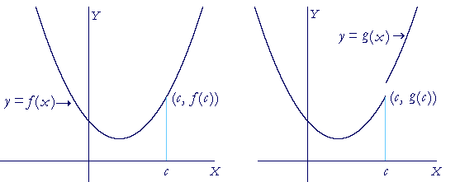
MOTIVATION

Slide 3
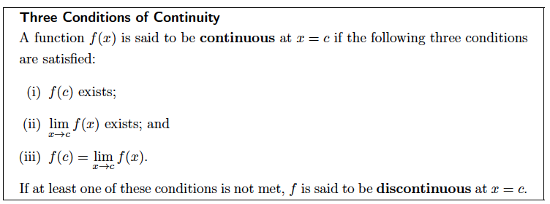

Slide 4

A function ƒ is said to be continuous at a point c if

Slide 5
A function ƒ is said to be continuous throughout its domain if it is continuous at every point in its domain
The continuity of functions real variable can be discussed
on the whole of R or in a subset of R.

Slide 6
Examples(Basic continuous functions)
Polynomials
Rational functions
Root functions
Trigonometric functions
Inverse trigonometric functions
Logarithmic functions
Exponential functions

Slide 7
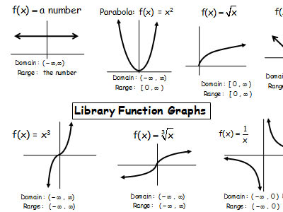

Slide 8
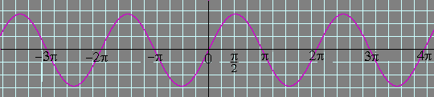
Here is the graph of y = sin x:

Slide 9
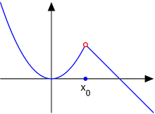

Slide 10
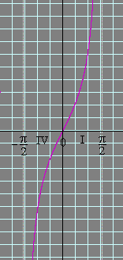
Here is one period of the graph of y = tan x:

Slide 11
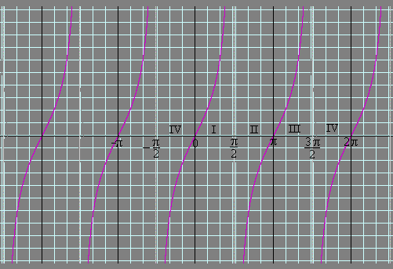
Here is the complete graph of y = tan x.

Slide 12
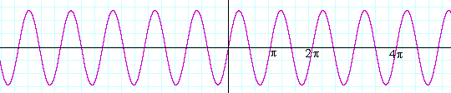
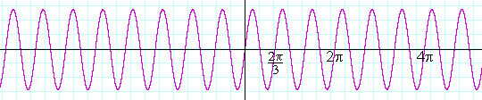
that means there are 2 periods in an interval of length 2π.
If a = 3 --
y = sin 3x
-- there are 3 periods in that interval:

Slide 13
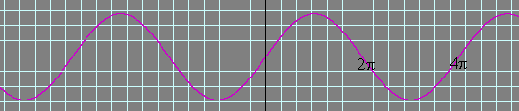
While if a = ½ --
y = sin ½x
-- there is only half a period in that interval:

Slide 14
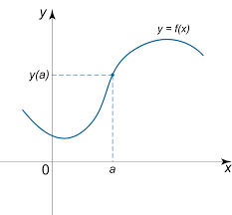

Slide 15
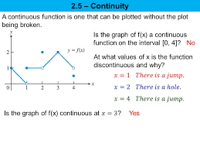

Slide 16
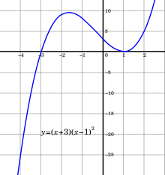

Slide 17
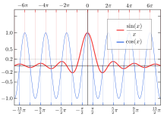

Slide 19
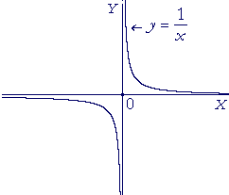

Slide 20
UNIFORM CONTINUITY
A function ƒ is said to be uniformly continuous if for every > 0 there exists a such that
where depends only on

Slide 21
Modulus of Continuity
One of the basic characteristics of continuous functions. The modulus of continuity of a continuous function on a closed interval is defined as

Slide 22
DIFFERENTIABLE FUNCTIONS
A function f is said to be differentiable at a point c if the following limit exists

Slide 23
CONTIUOUS BUT NOT DIFFERENTIABLE
f(x)=|x| is continuous but not differentiable.
-1
0
1

Slide 24
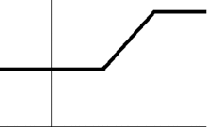

Slide 25
Differentiability classes
Consider an open set on the real line and a function f defined on that set with real values. Let k be a non-negative integer. The function f is said to be of class C^{k} if the derivatives f', f'', ..., f^{(k)} exist and are continuous
The function f is said to be of class C∞, or smooth, , if it has derivatives of all orders.

Slide 26
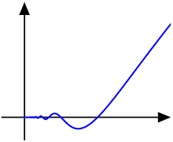
The function f(x)=x² sin(1/x) for x>0

Slide 27
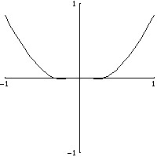

Slide 28
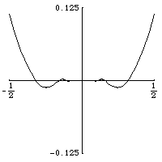

Slide 29
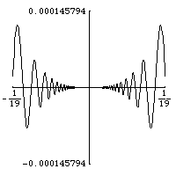

Slide 30

No where differentiable functions

Slide 31
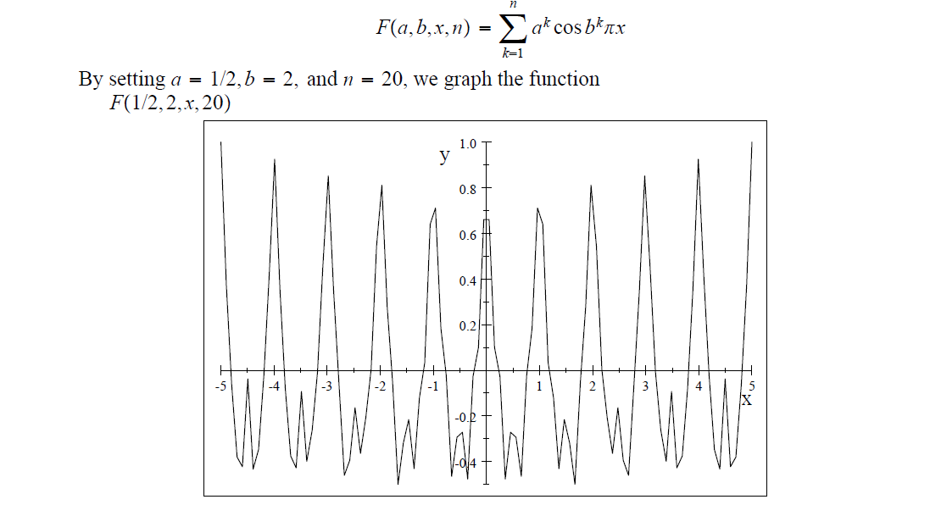

Slide 32
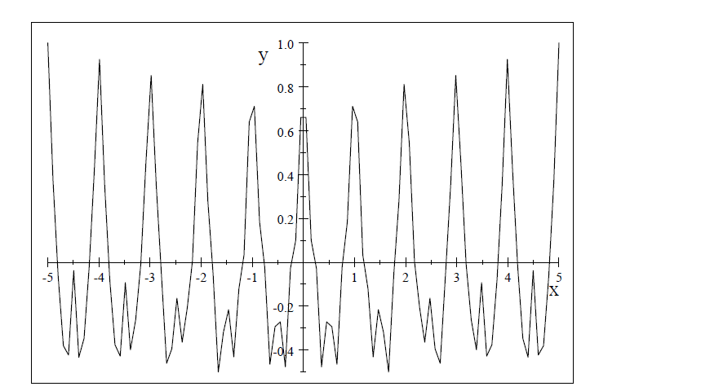

Slide 33
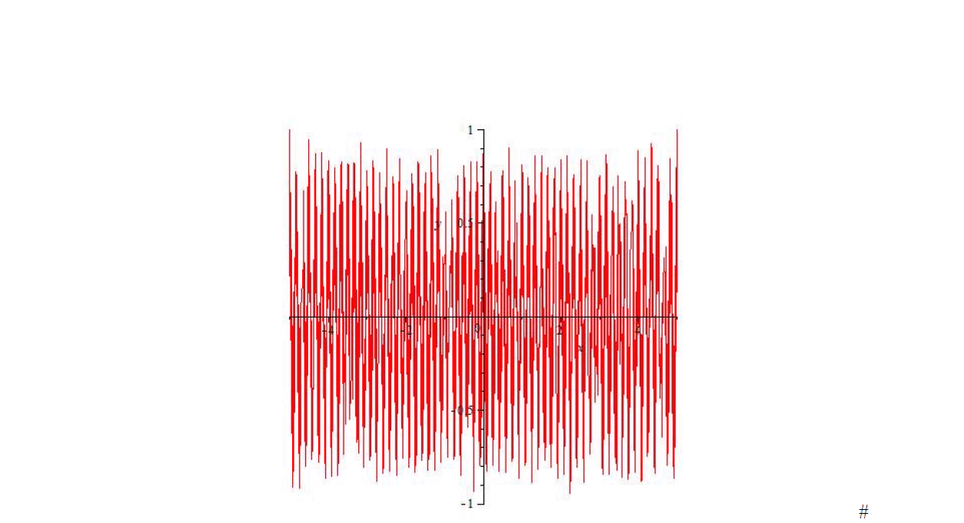


Slide 34

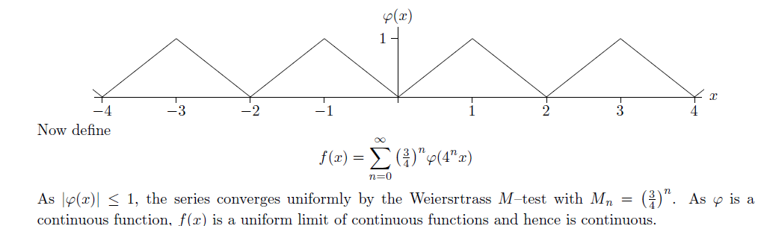

Slide 35
Approximation of continuous functions
Can a continuous function be approximated by any other class of Basic continuous functions?

Slide 36
Weiersrtrass Approximation Theorem
Any continuous function f defined on [a,b] can be approximated by a polynomial.
For each there exist a polynomial p(x) such that

Slide 37
Approximation by triginometric functions

Slide 38
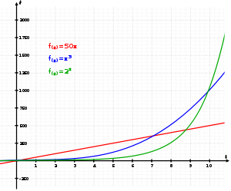
Convex continuous functions

Slide 39
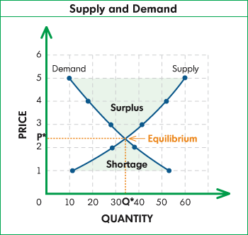
Applications to Economics

Slide 40
